Slide 1
Coca-Cola Power Bi Dashboard Analysis
Key Insights and Visualizations of Data
Abhishek Satija

Slide 2
Introduction
The main objective of this analysis is to find out comprehensive insight of different Coca-Cola product’s sales volume, revenue and operating profit.
Through this analysis we will find out when and where the most products are being sold more frequently and which gives the best profit based on retailers and product type.

Slide 3
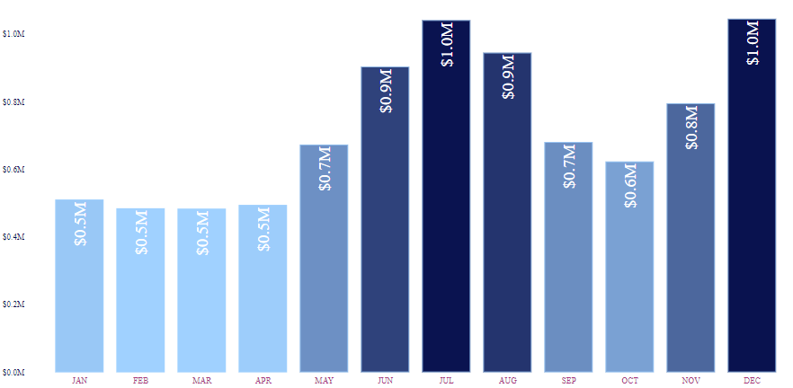
Sales Performance Overview
As we can see from the Bar-chart the total sales figures and trend over the time period of one year.

Slide 4
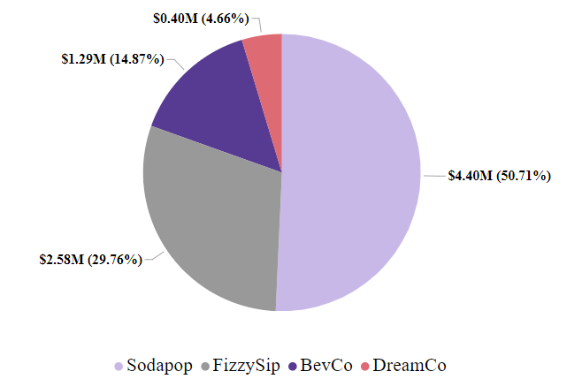
Sales Performance Overview
As for the retailer, From the chart we can see that mostly sales are contributed by Sodapop and FizzySip. That makes more than three quarter of total sales.

Slide 5
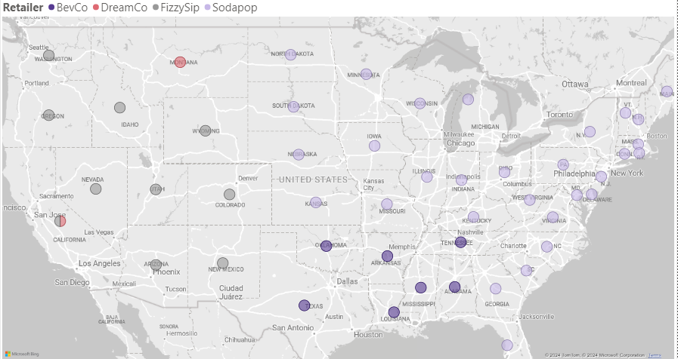

Slide 6
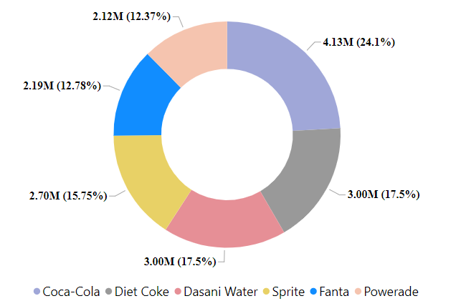
Market of Units sold
As for the units sold in the market, the most favorable product is the original Coca-Cola. The second and third most popular products are Diet Coke, Dasani Water, and Sprite, respectively.
Together, these products constitute one-third of the total market share in terms of units sold.

Slide 7
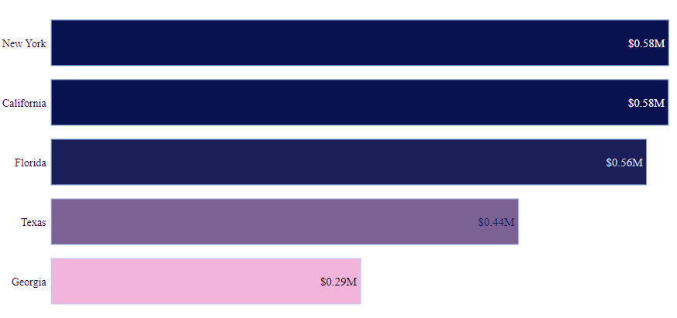
Market of Units sold
As seen in the graph, the highest number of units that are sold in the regions are New York, California, Florida, Texas and Georgia.
The most units are sold in South and North east and West of the USA rather than South and Midwest and part.
That gives an insight that the most contributed profits are made from the most easter and western part of the USA.

Slide 8
Strategic Recommendations
From the analysis, we can clearly observe that sales peak in the months of July and December, while the period from January to April sees the lowest sales volumes.
Additionally, the cost of distribution can be reduced by strategically positioning retail stores closer to high-sales regions such as New York and California.
Apart from Coca-Cola, Dasani Water and Sprite are also favored by customers, suggesting that increased marketing efforts for these products could significantly boost profits.
Notably, products like Coca-Cola and Dasani Water contribute the highest profit margins, almost 40%.

Slide 9
Conclusion
In conclusion, the analysis provides valuable insights to the Coca-Cola company and its various products.
Geographically, particular regions like California, New York, Georgia and Florida leads in sales volume providing insight that how important are those region in market for the company’s profit.
Also seasonal impact on the sales and profit can be clearly seen with most sales occurring in July and December while lowest sales in first quarter.
To optimizing distribution cost the retailer store should be near high sales area like, New York and California.
Overall, Coca-Cola and Dasani Water provide most marginal profit and also favored by the customer along with Diet Coke and Sprite.
By leveraging these insights, Coca-Cola can strategically enhance its market presence, optimize operational efficiency, and maximize profitability.

Slide 10
Thank You

